Slide 1


A J INSTITUTE OF ENGINEERING AND TECHNOLOGY
(A unit of Laxmi Memorial Education Trust®)
PRESENTATION ON
Interpretations Management App
UNDER THE GUIDENCE
Vidya Myageri
Assistant Professor, Dept of CSE
AJIET, Mangalore
PRESENTED BY
GAURESH G PAI [4JK22CS016]
Dept of CSE
AJIET, Mangalore

Slide 2
Effortlessly manage interpretations with this Next.js app backed by AppWriter. View, edit, and delete interpretations with ease.
Simplify your interpretation management tasks today! 🌟
This web application allows users to manage interpretations, providing a platform to view, edit, and delete interpretations stored in the database. It utilizes Next.js for the frontend and AppWriter as the backend service.
✨ Features
View Interpretations: 👀 Users can view a list of interpretations fetched from the backend.
Edit Interpretations: ✏️ Users can navigate to edit interpretation pages for making changes.
Delete Interpretations: 🗑️ Users can delete interpretations directly from the list.
🛠️ Technologies Used
Frontend: Next.js, React
Backend: AppWriter (No SQL structure)
Styling: Tailwind CSS

Slide 3
An interpretation refers to the process of explaining, understanding, or making sense of something.
async function fetchInterpretation(id: string) {
try {
const interpretation = await database.getDocument(
process.env.NEXT_PUBLIC_APPWRITE_DB_ID as string,
"interpretations",
id
);
return interpretation;
} catch (error) {
console.error('Error fetching interpretation:', error);
throw new Error("Failed to fetch interpretation");
}
}
async function deleteInterpretation(id: string) {
try {
const response = await database.deleteDocument(
process.env.NEXT_PUBLIC_APPWRITE_DB_ID as string,
"interpretations",
id
);
return response;
} catch (error) {
console.error('Error deleting interpretation:', error);
throw new Error("Failed to delete interpretation");
}
}
Fetch function which takes care about the retrieving of the data to the website dashboard(databse too)
async function updateInterpretation(id: string, data: { term: string, interpretation: string }) {
try {
const response = await database.updateDocument(
process.env.NEXT_PUBLIC_APPWRITE_DB_ID as string,
"interpretations",
id,
data
);
return response;
} catch (error) {
console.error('Error updating interpretation:', error);
throw new Error("Failed to update interpretation");
}
}
Delete function takes care about the deleting of the data from the website dashboard(database too)
Updating function takes care about the eliminating the data from the website dashboard(database too)

Slide 4
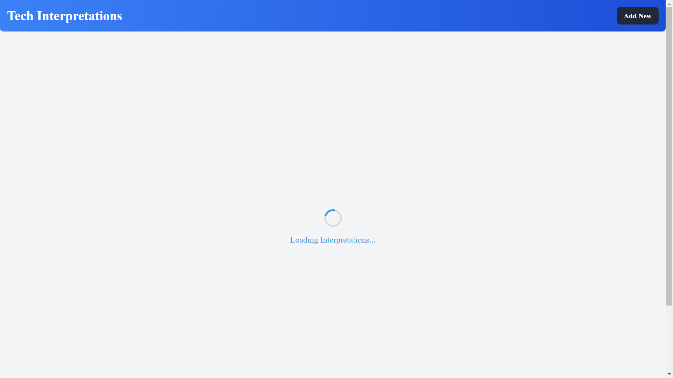
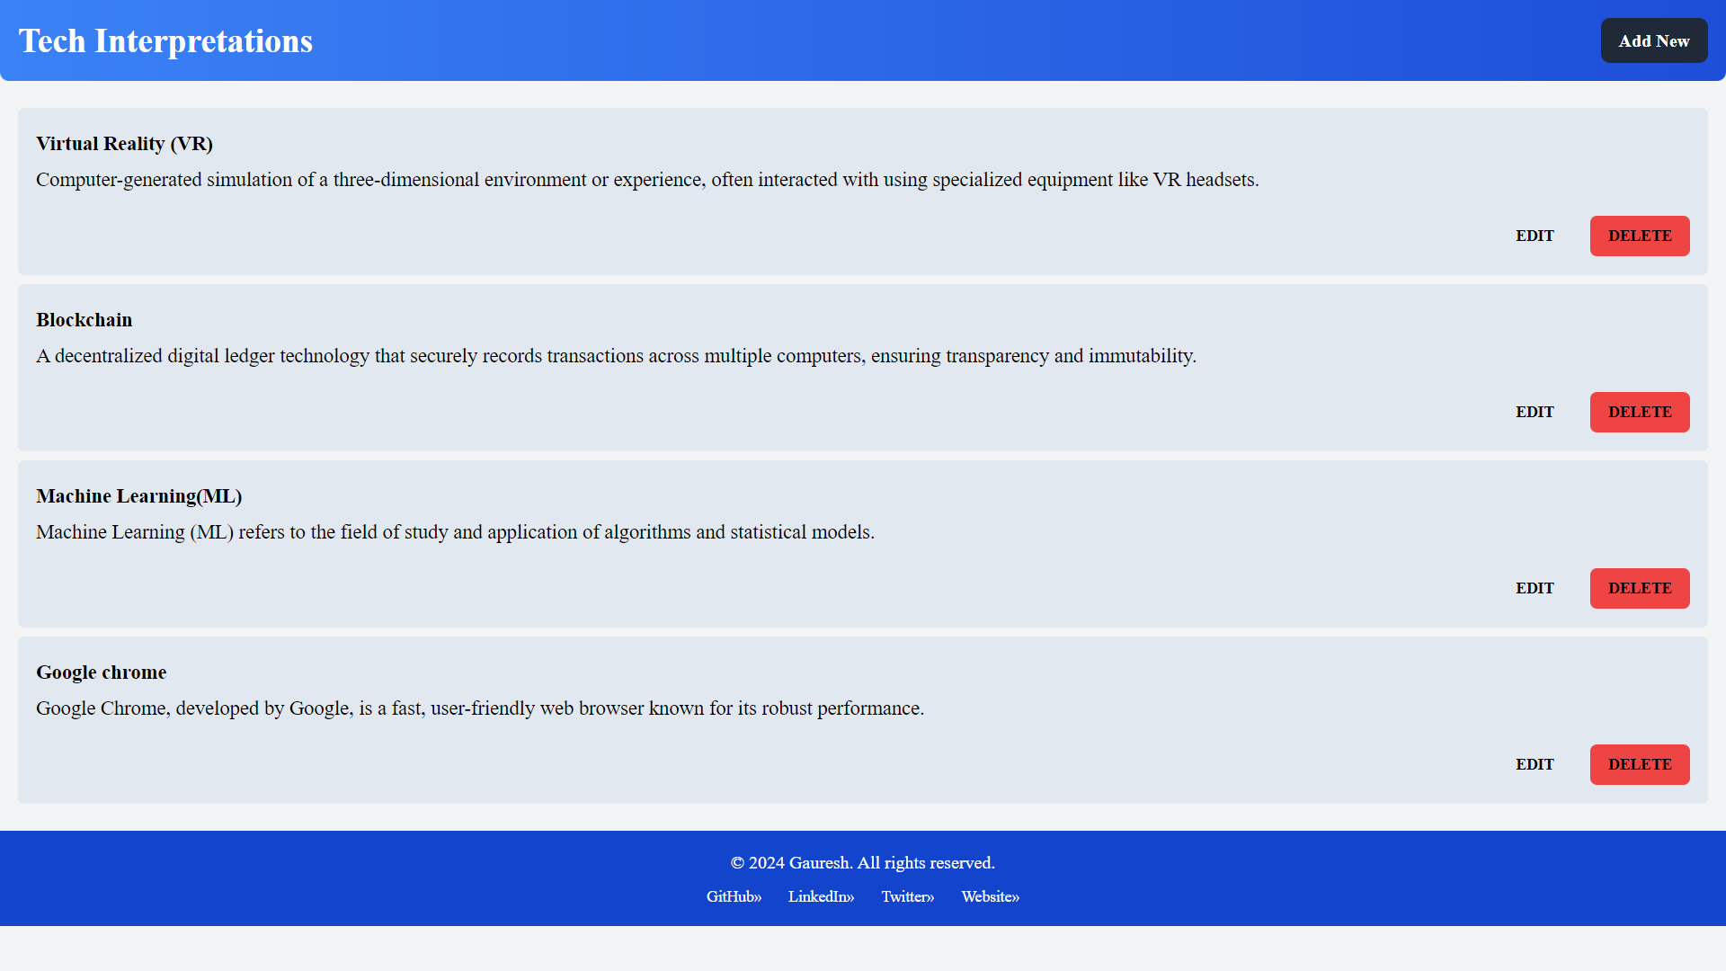
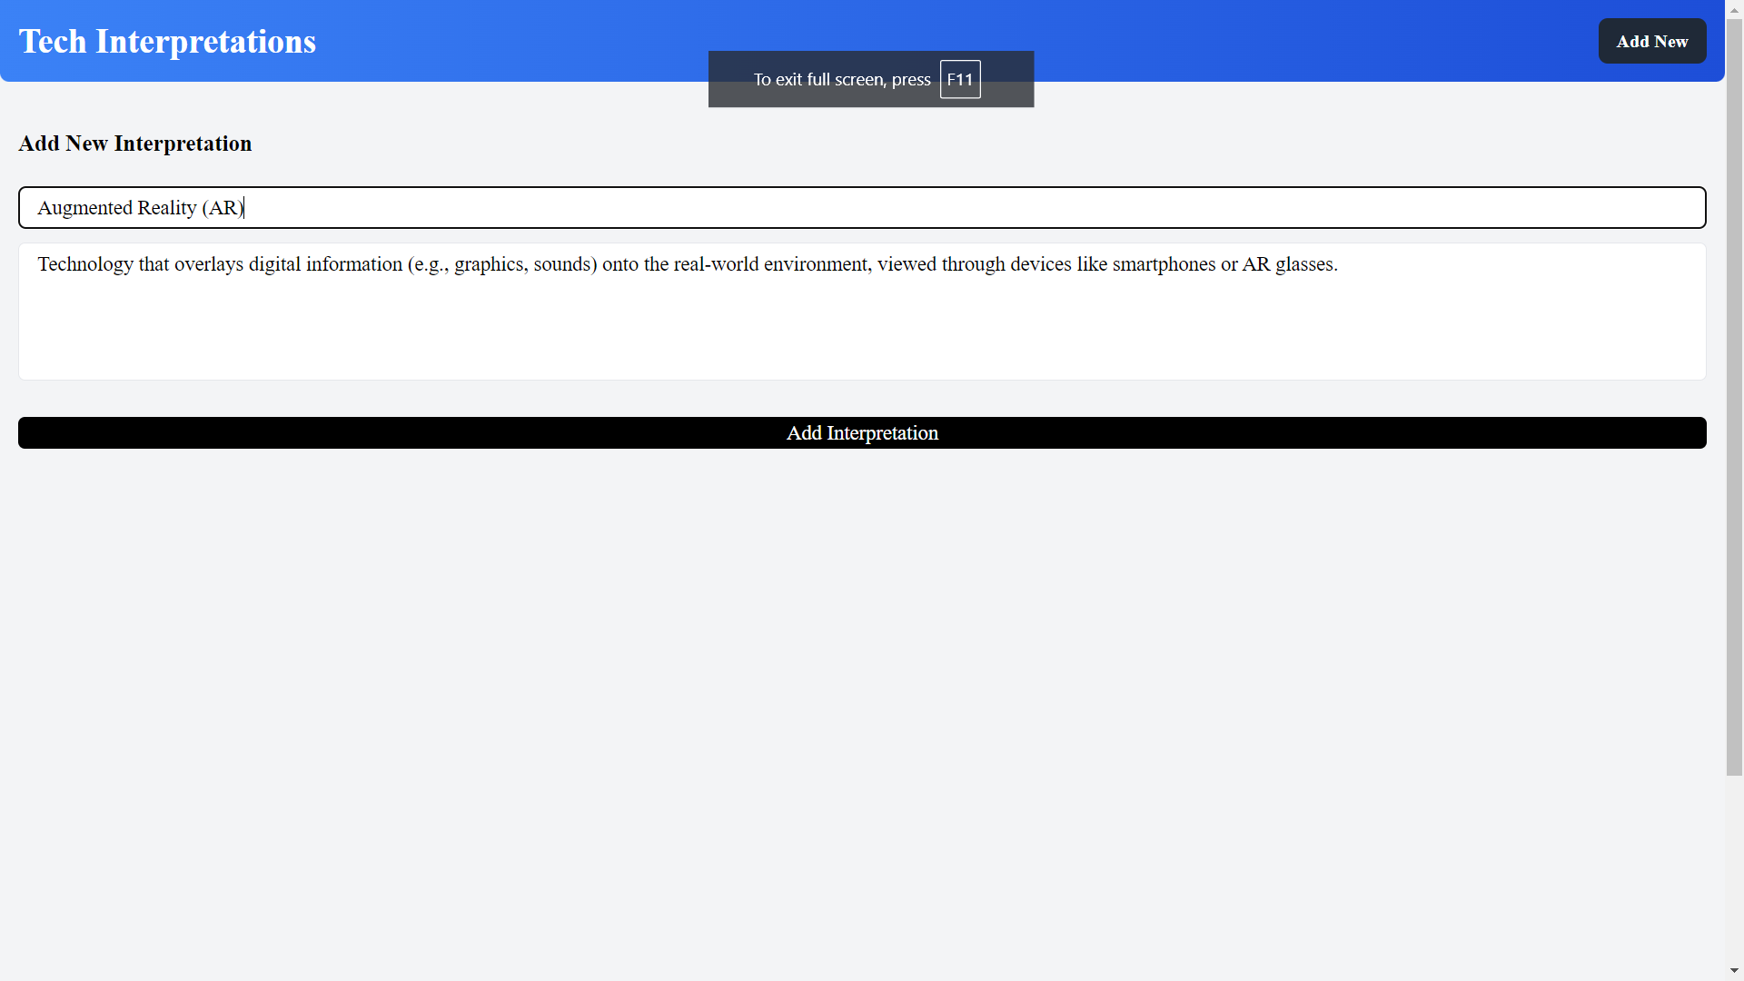
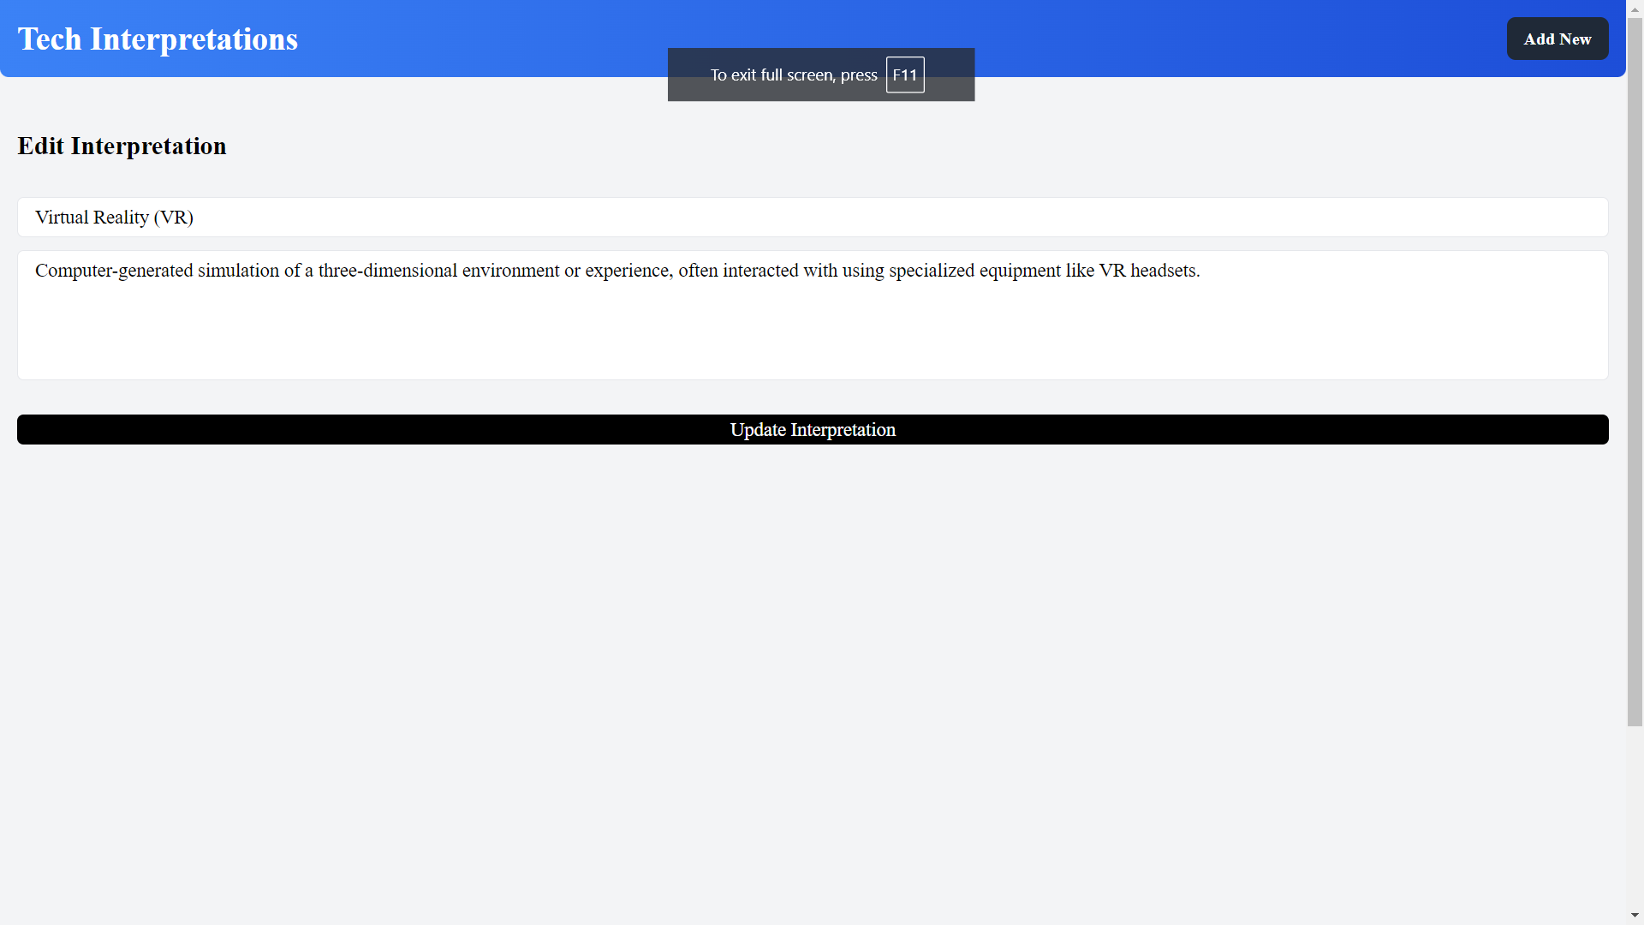
ER Diagram
NoSQL Structure
User
_id
{
"_id": "",
"term": "",
"content": ""
}
Interpretation
_id
item
Content
Thankyou

